Slide 1
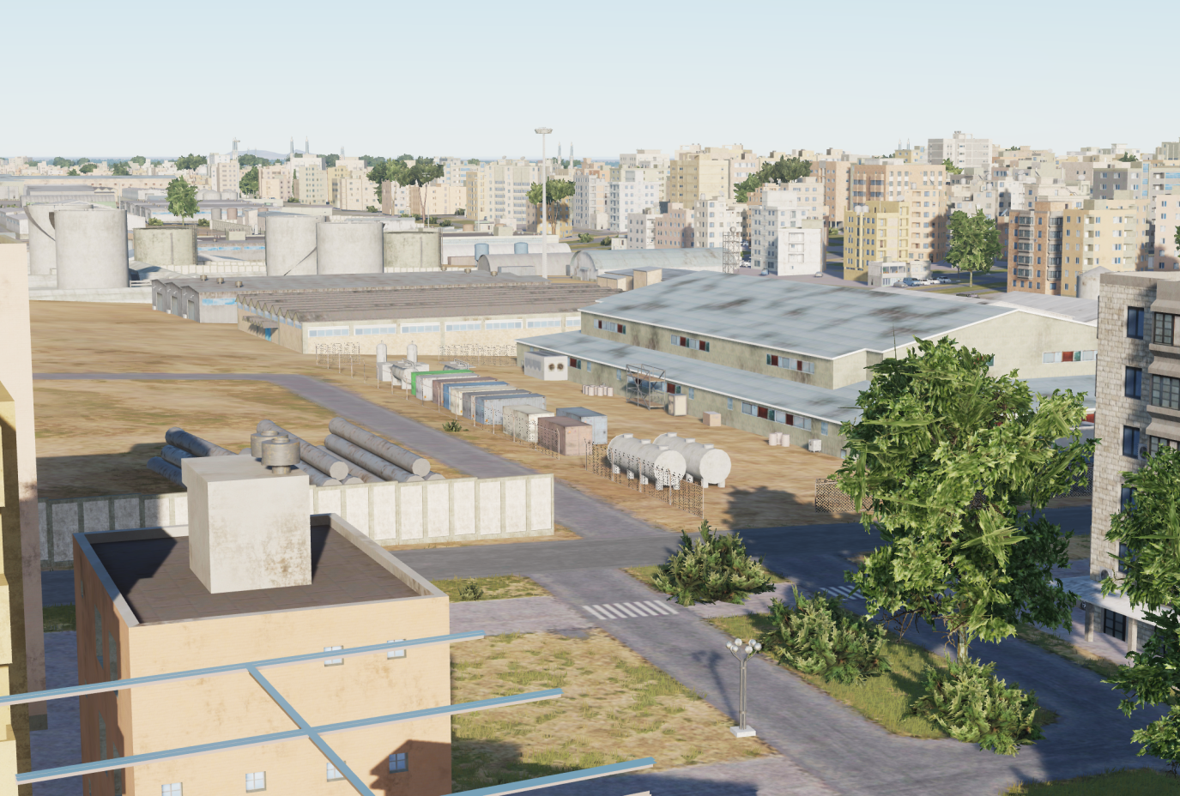

SYTGT022 Vehicle Factory
N
22
5
6
2
4
1
3
DESCRIPTION OF THE DESIRED POINTS OF IMPACT WITH WPN TYPE:
SYTGT022A – Production Plant
DPI 1 – N35 58.066 E 039 00.627/807ft /1000 Ibs bomb
DPI 2 – N35 58.067 E 039 00.652/806ft /1000 Ibs bomb
SYTGT022B – Assembly Hall
DPI 3 – N35 58.085 E 039 00.686/812ft/ 1000 Ibs bomb
DPI 4 – N35 58.070 E 039 00.687/807ft/ 1000 Ibs bomb
SYTGT022C – Assembly Hall
DPI 5 – N35 58.085 E 039 00.716/811ft/ 500 Ibs bomb
DPI 6 – N35 58.073 E 039 00.718/806ft/ 500 Ibs bomb
Flammables filled siloses
residential districts surrounding the SYTGT022
7
8

Slide 2
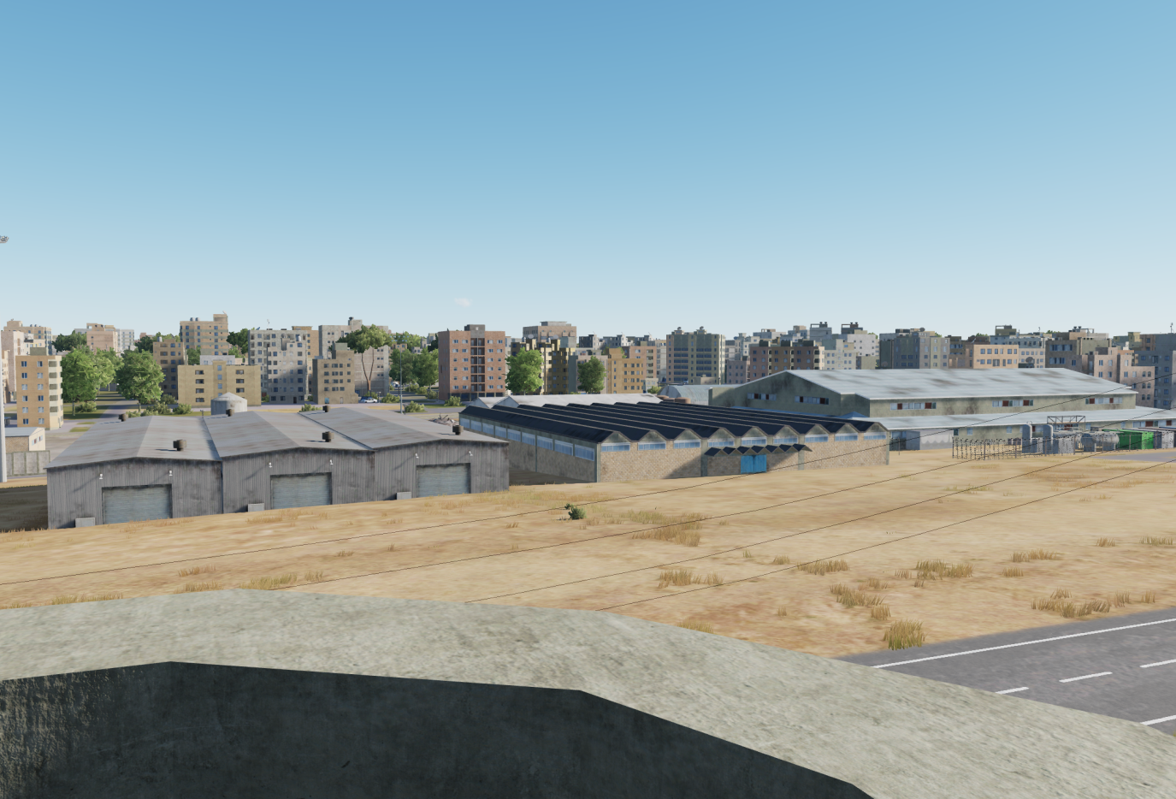
SYTGT022 Vehicle Factory
N
22
1
2
1
6
4
3
5
DESCRIPTION OF THE DESIRED POINTS OF IMPACT WITH WPN TYPE:
SYTGT022A – Production Plant
DPI 1 – N35 58.066 E 039 00.627/807ft /GBU-32/GBU-16
DPI 2 – N35 58.067 E 039 00.652/806ft /GBU-32/GBU-16
SYTGT022B – Assembly Hall
DPI 3 – N35 58.085 E 039 00.686/812ft/ GBU-32/GBU-16
DPI 4 – N35 58.070 E 039 00.687/807ft/ GBU-32/GBU-16
SYTGT022C – Assembly Hall
DPI 5 – N35 58.085 E 039 00.716/811ft/ GBU-38/GBU-12
DPI 6 – N35 58.073 E 039 00.718/806ft/ GBU-38/GBU-12
Flammables filled siloses
residential districts surrounding the SYTGT022
8

Slide 3
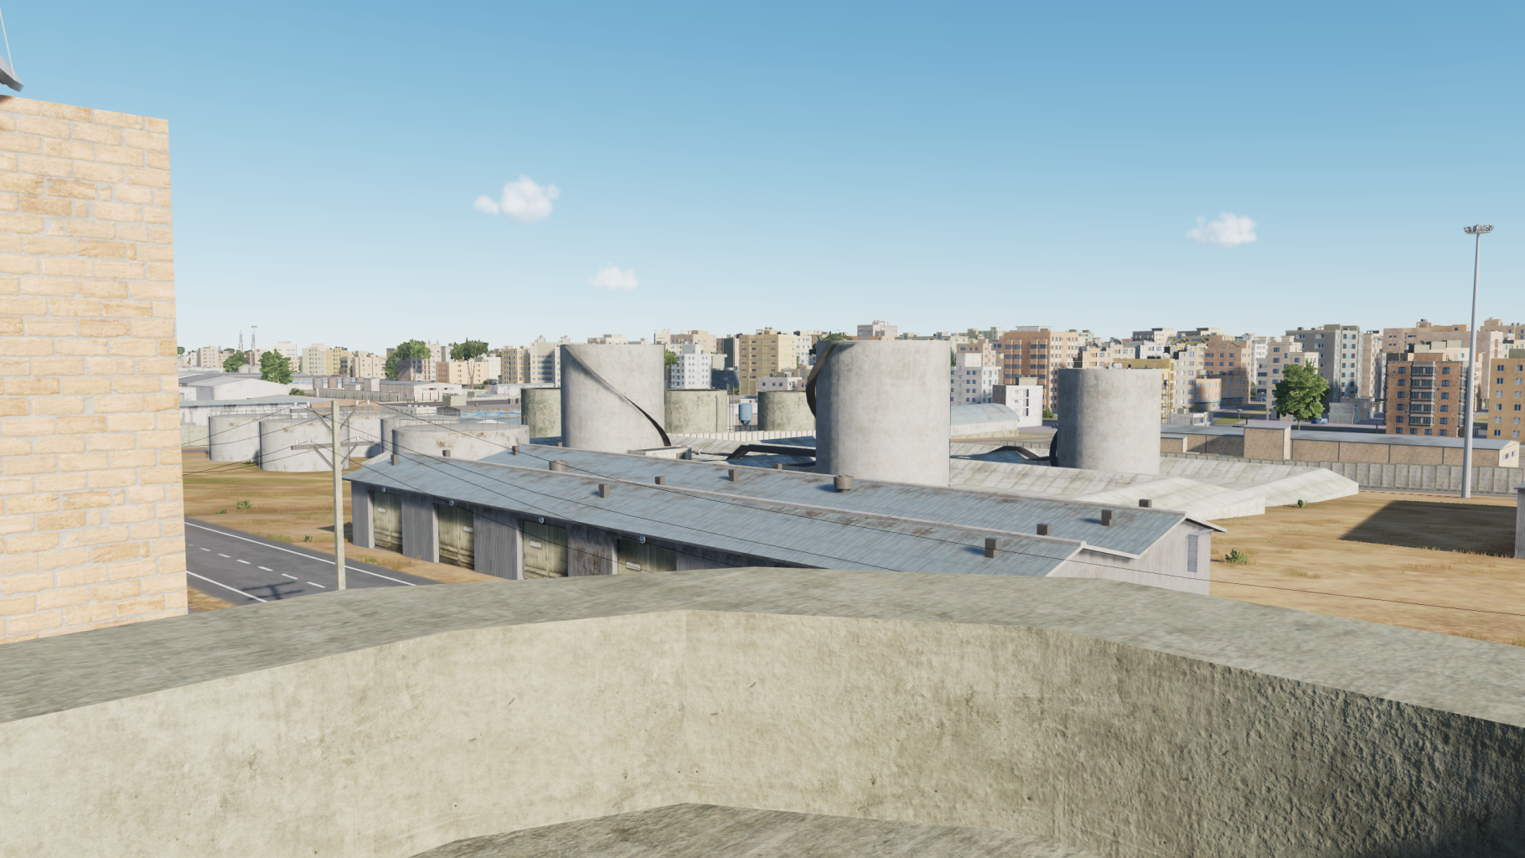
SYTGT022 CDC
COLLATERAL DAMAGE CONCERN (CDC)
9x Siloses filled with flammables.
Residential districts surround the SYTGT022
N
Siloses
Siloses
SYTGT022C
1
1
25m
2
3
4
5
6
7
8

